Slide 1
WELCOME
ALL grade 7 STUDENTS

Slide 2
UNIT 7: THE WORLD OF WORK
Section B: THE WORKER - B 1, 3, 4

Slide 3
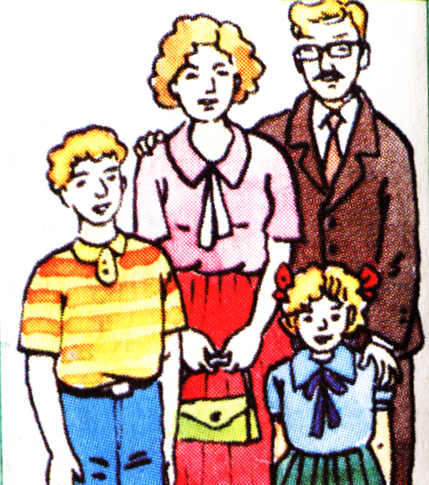
B 1. A letter from Tim Jones (p. 76)
Mrs. Jones
Mr. Jones
Tim
Shannon

Slide 4
A letter from Tim Jones
July 3
Dear Hoa,
I’m pleased that you and your family are well. I am fine, too. Here is a picture of me, my Mom and Dad and my sister, Shannon. Can you send me a photo of you?
Let me tell you more about my parents.
My Mom works at home. She takes care of the family. Three mornings a week, she works

Slide 5
A letter from Tim Jones
part-time at a local supermarket. She and other women also cook lunch for homeless people once a week.
My Dad is a mechanic. He repairs machines in a factory. He works five days a week for about 40 hours, sometimes in the morning and sometimes in the afternoon. He prefers the morning shift.

Slide 6
A letter from Tim Jones
He has fewer days off than my Mom. However, when he has an afternoon free, he plays golf.
Dad gets about seven public holidays each year. He also has a three-week summer vacation. We always go to Florida on vacation. We have a great time and Dad plays more golf.

Slide 7
A letter from Tim Jones
Please write soon and tell me more about your family.
Best wishes,
Tim

Slide 8
NEW WORDS
- part-time (adj/adv)
part of the day or week in which people work
Ex: Liz works part-time from 10 am till 2 pm.

Slide 9
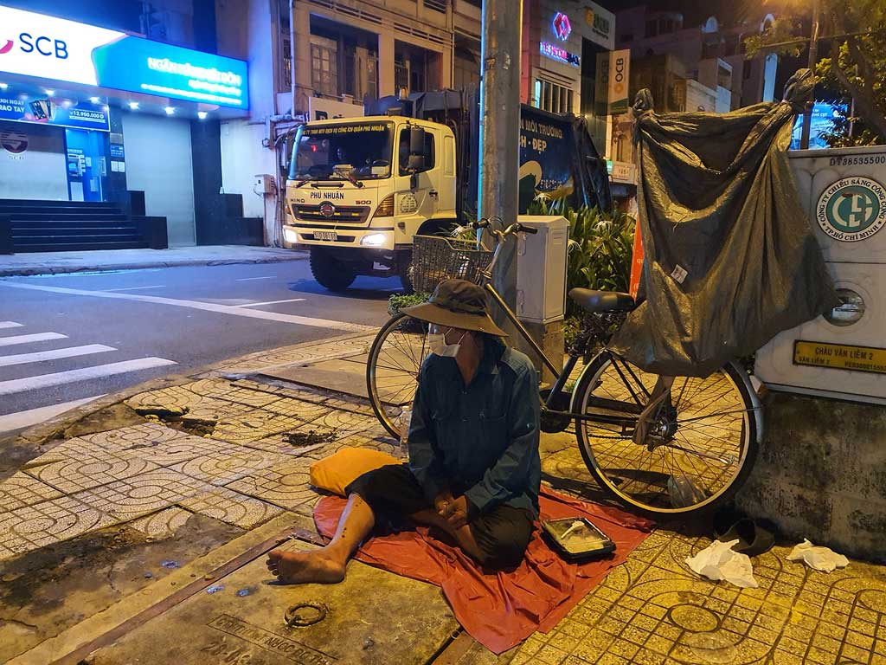
NEW WORDS
- part-time (adj/adv)
- homeless (adj)

Slide 10
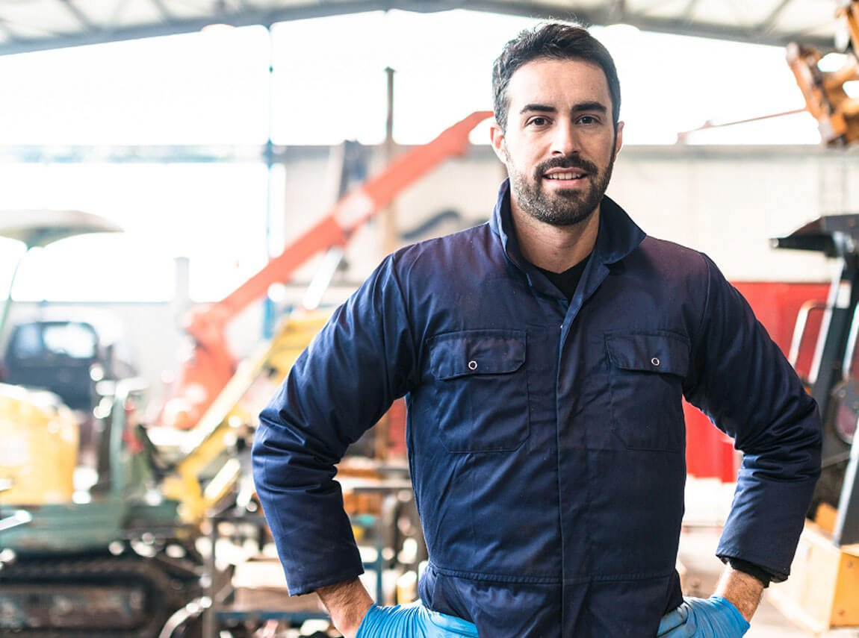
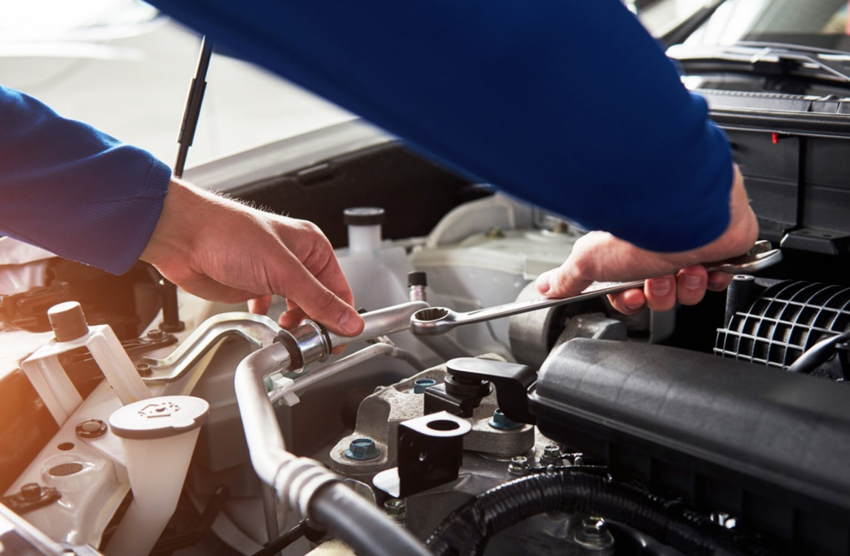
NEW WORDS
- part-time (adj/adv)
- homeless (adj)
- mechanic (n)

Slide 11
NEW WORDS
- part-time (adj/adv)
- homeless (adj)
- mechanic (n)
- shift (n)
a period of time worked by a group of workers who start work as another group finishes
Ex: He has to take night shifts twice a week.

Slide 12
NEW WORDS
- part-time (adj/adv)
- homeless (adj)
- mechanic (n)
- shift (n)
- prefer (v)
to like one thing or person better than another; to choose one thing rather than something else because you like it better
Ex: ‘Coffee or tea?’ ‘I'd prefer tea, thanks.’

Slide 13
NEW WORDS
- part-time (adj/adv)
- homeless (adj)
- mechanic (n)
- shift (n)
- prefer (v)
- day off (n)
day when you do not work
Ex: Tomorrow is my day off.

Slide 14
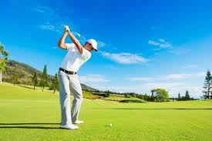
NEW WORDS
- part-time (adj/adv)
- homeless (adj)
- mechanic (n)
- shift (n)
- prefer (v)
- day off (n)
- golf (n)

Slide 15
Grammar
1.
Comparison with noun (so sánh hơn với danh từ)
Form:
So sánh nhiều hơn: … more + Ns/N + than …
So sánh ít hơn: … fewer + Ns + than …
… less + N + than …
Notes: - N: danh từ không đếm được, số ít
- Ns: danh từ đếm được, số nhiều
Ex: - Hoa works more hours than some workers.
- My father has fewer days off than my Mom.
- Jane drinks less milk than her sister.

Slide 16
TRUE OR FALSE?
T F
1. Tim tells Hoa about his friends.
✓
family
2. His mother takes care of his family and sometimes cooks lunch for homeless people.
✓
3. His father works about 40 hours a month.
✓
week
4. Tim’s father has more days off than his mother.
✓
fewer

Slide 17
Answer the questions.
a) Where does Mrs. Jones work?
b) What does she do for homeless people?
c) What is Mr. Jones' job?
d) How many hours a week does he usually work?
e) How do you know the Jones family likes Florida?

Slide 18
Answer the questions:
a) Where does Mrs. Jones work?
- Mrs Jones works at home. But three mornings a week she works part-time at a local supermarket.
b) What does she do for homeless people?
- She cooks lunch for homeless people once a week.
c) What is Mr. Jones' job?
- Mr. Jones is a mechanic. He repairs machines in a factory.

Slide 19
Answer the questions.
d) How many hours a week does he usually work?
- He works about 40 hours a week.
e) How do you know the Jones family likes Florida?
- The John family always goes to Florida on vacation. They have a great time there.

Slide 20
B 3. Compare.
Read Tim’s letter and the text about Mr. Tuan (B2 p. 77). Then make notes about them.
 | Hours per week | Days off | Vacation time
Mr. Jones
Mr. Tuan
40
15
7
42
4 or 5
no

Slide 21
B 4. Listen and take notes.
Name | Job | Hours per week | Amount of vacation
Peter
Susan
Jane
Phong
A four-week vacation
doctor
70
A three-week vacation
nurse
50
shop assistant
A one-week vacation
35
factory worker
A two-week vacation
48

Slide 22
Homework
1. Learn new words by heart.
2. Prepare Unit 8: Places (A 1, 2, 3)

